Slide 1


SpotiQuiz
A project developed for the course "Design and implementation of mobile applications".
Academic Year: 2022/2023

Slide 2
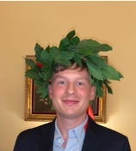
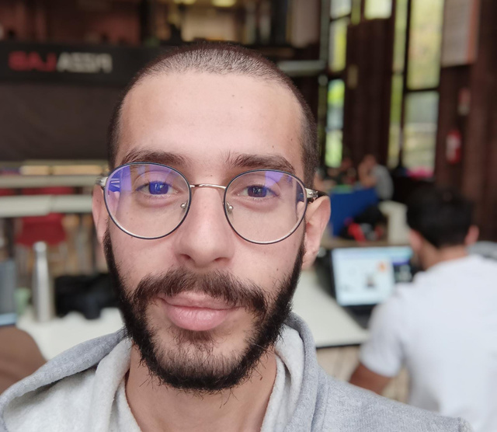
Our Team
Riccardo Casciotti
Ivan Crusco
Computer scientist
Attending "Master in Computer Science" at Politecnico di Milano
Computer scientist
Attending "Master in Computer Science" at Politecnico di Milano

Slide 3

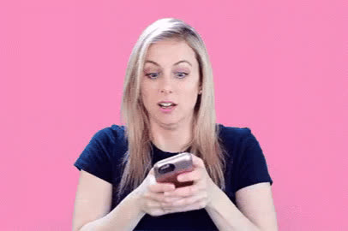

Our goal
Create a mobile application for smartphone and tablet
Let users log in into their Spotify accounts through It
Play quizzes based on their favourite artists and songs

Slide 4


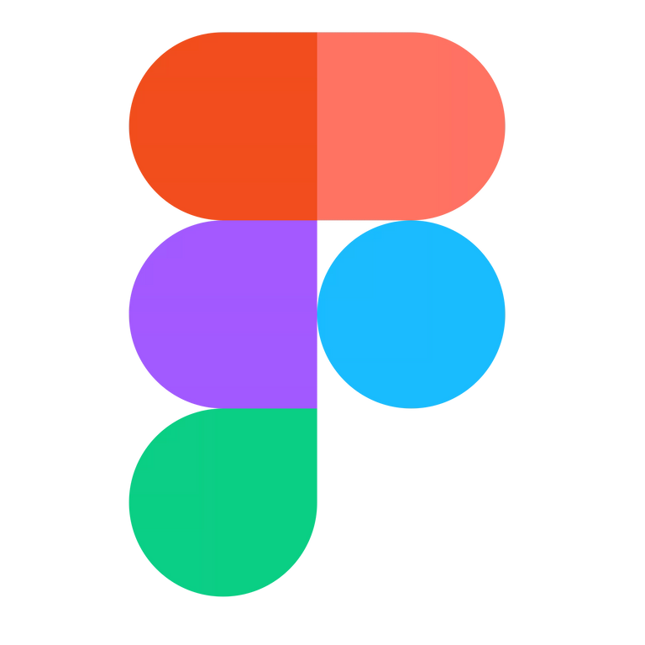






Process
Choosing the framework for the implementation
Prototyping the app and its main functionalities
Design choices
"How should the app feel?"
Splitting the tasks and creating a workplan to start

Slide 5
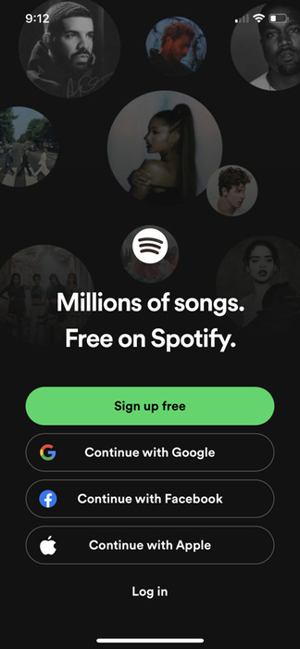
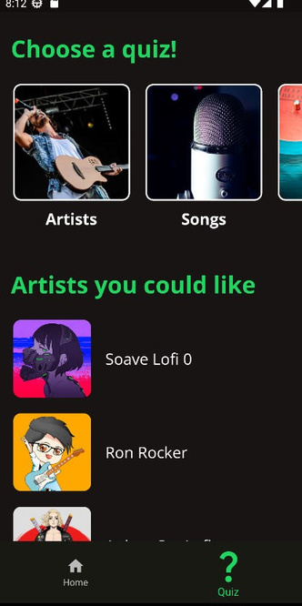
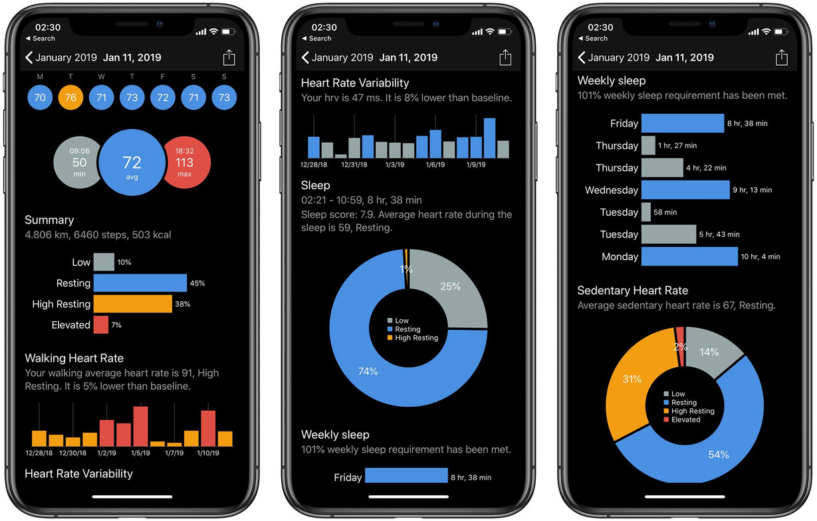


Design choices
Usage of the same green, black and white tonalities from the official Spotify documentation
Minimal and Spotify driven design
The app should remember Spotify and
be fast and easy to use
Simple and meaningful widgets, avoiding the overload of screens with unnecessary informations

Slide 6







Key features
Multi-device support
Developed for tablet and
smartphone with
different layouts
Adaptability
Supporting both
portrait and landscape
orientation
Appropiate usage of data
Persistent data collection and
asynchronus screens population
Localization
Available in 6 languages
Deeply tested
A campaign of 266 Widget,
Unit and Integration tests

Slide 7

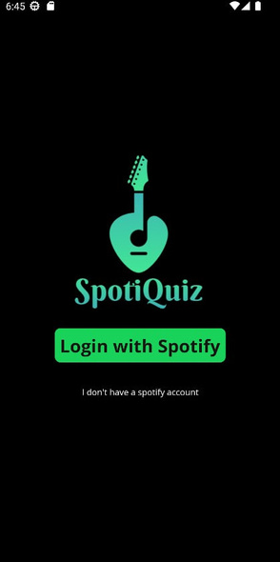




Components
Firebase Database
Spotify API
Geocoding API
Events API
from Rapid API
External libraries

Slide 8




Quiz implementation
5 Modalities
Different type of quizzes
related to artists, songs
and albums
Endless quizzes
A user can play as much as
wanted, we will continously
generate new questions
Tailored questions
Our questions generator is
based on the list of favourite
artists and songs of the user
Listen and answer
Thanks to the playback function of Spotify, listening to the songs in the app is possible

Slide 9
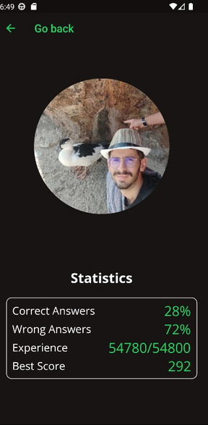
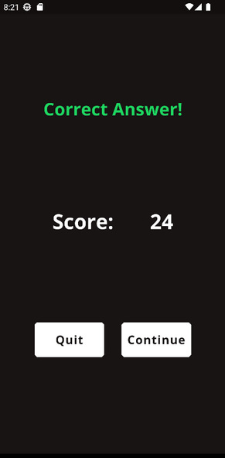
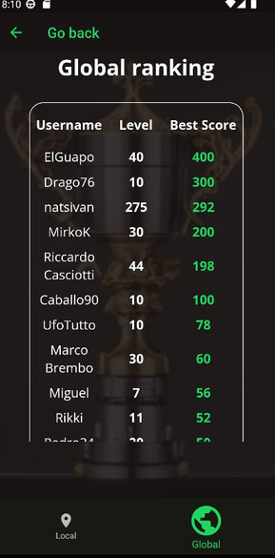
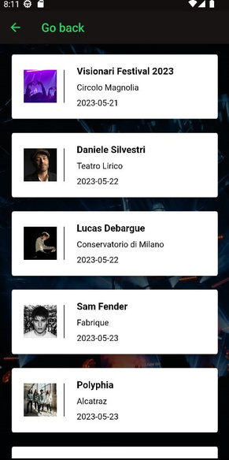
Gamification & Events
Beyond the quiz
The user will be able to track the progress
in the application and to compete with other players around the world
Helping music lovers
The app can display a list of music events happening close to the user in the next days

Slide 10
Thanks for the attention!

Slide 11
DEMO

